Slide 1

Credit card fraud detection
Harshini
Shreya
Aarjav

Slide 2
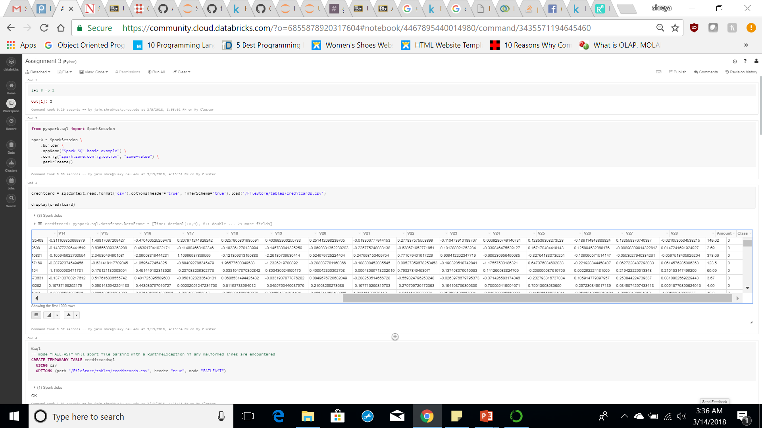
PROBLEM STATEMENT
To model the features in the given data set and use this model to examine a credit card transaction and classify it to be fraudulent or otherwise and achieve 100% Credit Card Fraud Detection while minimizing the incorrect Fraud predictions.
Notes:
Growing problem worldwide
Costs more than billions of dollars every year

Slide 3
Credit card Fraud Detection
Our datasets contains transactions made by credit cards in September 2013 by European cardholders, where there are 492 frauds out of 284,807 transactions.
Note: Dataset provided was already pre processed and PCA transformed due to confidentiality issues.
Target Variable: Class
0 → Normal Transactions (Non-Fraud)
1 → Fraud Transactions (Fraud)
Notes:
For confidentiality, dataset has

Slide 4
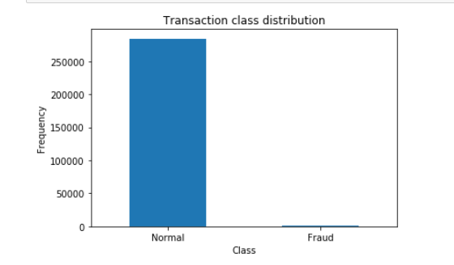
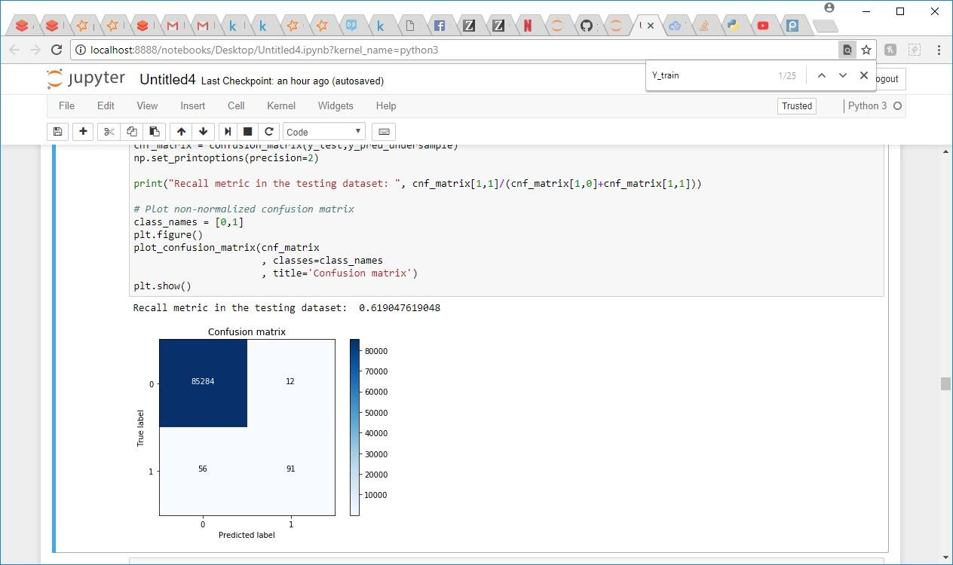
Unbalanced Dataset

Slide 5
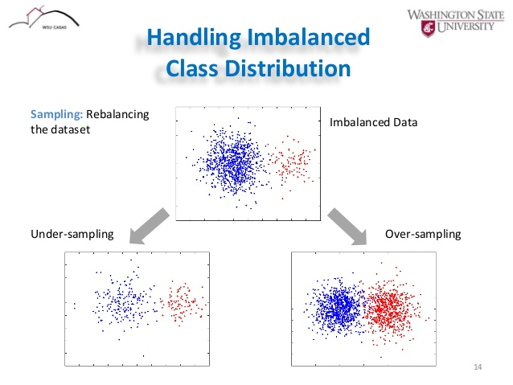
Handling Imbalanced Dataset
SMOTE
RANDOM FOREST

Slide 6
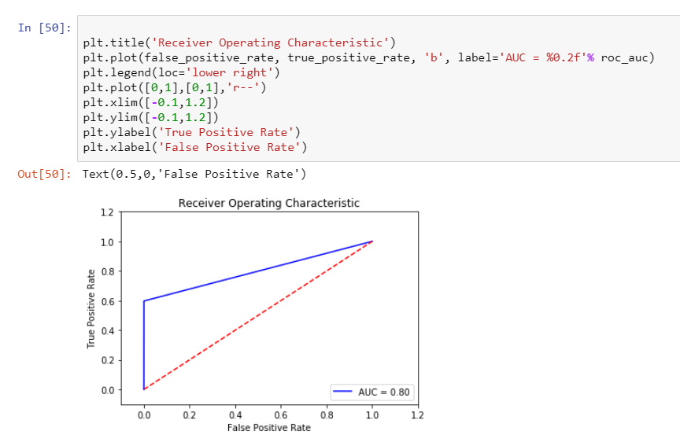
Logistic Regression

Slide 7
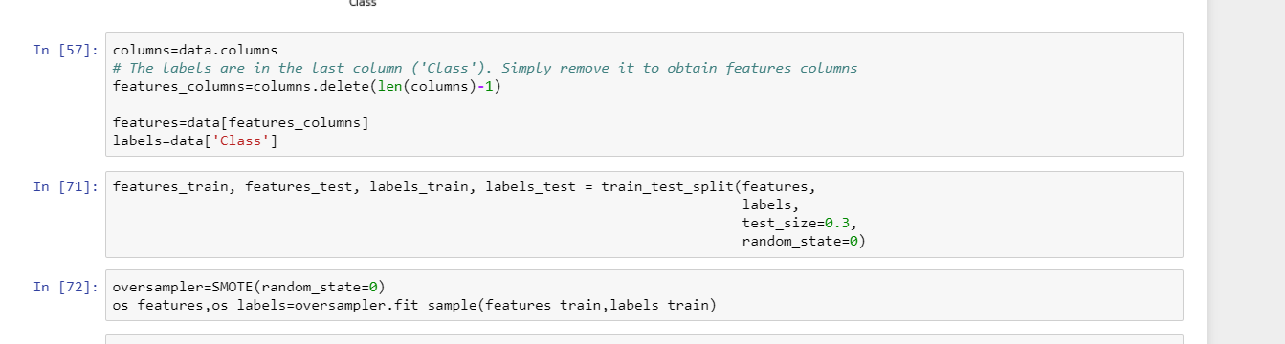
Applying smote to dataset

Slide 8
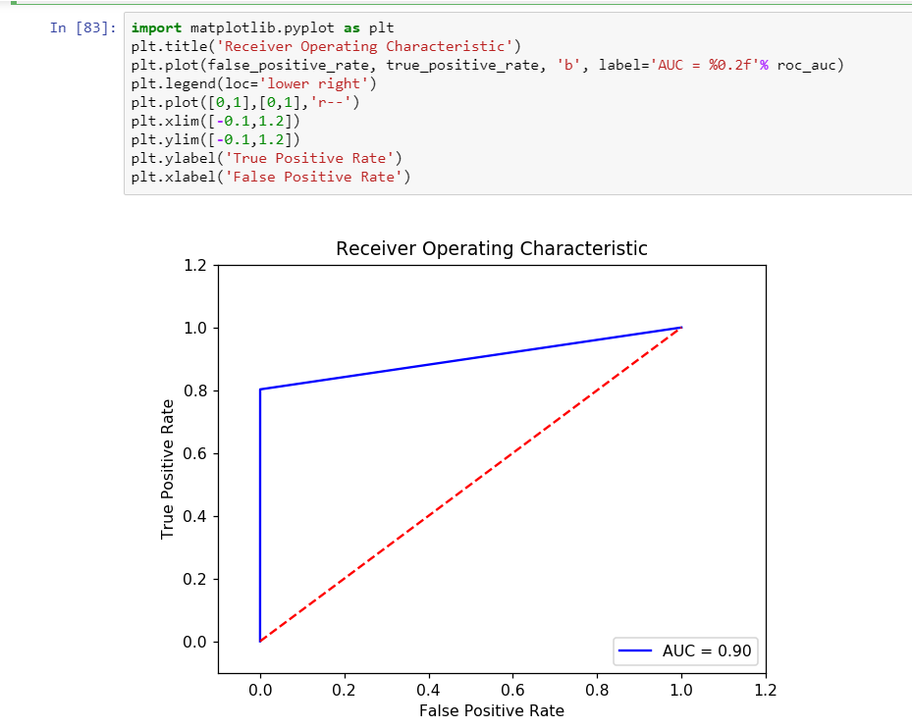
Perform training of the random forest using the (over sampled) train set
Performed Random forest using Oversampled train dataset
AUC: 0.90

Slide 9

Undersampling
Performed Random forest using Oversampled train dataset
AUC: 0.92

Slide 10
Future implementations
SVM
PCA
Threshold Calibration

Slide 11
Thank You

